Slide 1


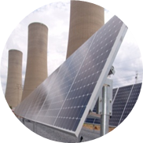
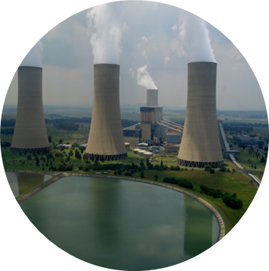
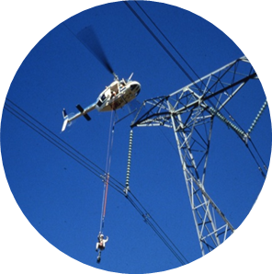
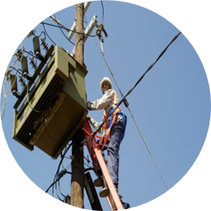

EIT Progress Assessment 3
Presented by: Khutso Makena
Unique Number: 4542278
Date :19-Oct-2018
Mentor: Adesh Singh
Chief mentor: Sidwell Mtetwa

Slide 2
Presentation Outline
Introduction
Outline of Training Schedule Completed
Eskom life saving rules
Elective-Line Engineering Services (LES)
Future work
Value added

Slide 3
Introduction
Name | Khutso Makena
Degree | BEng. Electrical Engineering (Heavy Current)
University | UP
Mentor | Adesh Singh
Chief mentor | Sidwell Mtetwa

Slide 4
Outline of Training Schedule Completed
Department | Duration
Lines Engineering Services (LES) | 5 months

Slide 5
Eskom 5 Life Saving Rules
RULE 1: OPEN, ISOLATE, TEST, EARTH, BOND and/or INSULATE BEFORE TOUCH
RULE 2: HOOK UP AT HEIGHTS
RULE 3: BUCKLE UP
RULE 4: BE SOBER
RULE 5: ENSURE THAT YOU HAVE A PERMIT TO WORK
20 10-Oct-172017
5
5

Slide 6
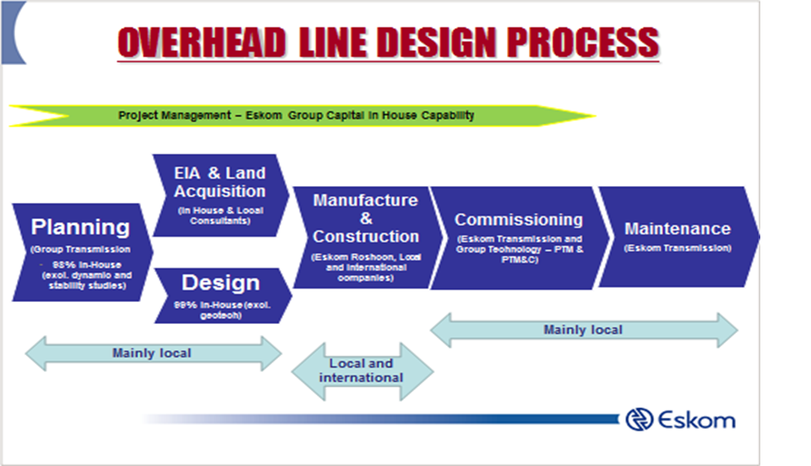
Line Engineering Services
Design and construction of overhead powerlines

Slide 7
Project : 275kV Bypass design
The following is understood from report TRC-RP0001 complied by the Tx Central Grid:
Eiger substation is situated in Alberton
A plant condition criticality assessment (CCRA) was conducted at Eiger to evaluate the health of the existing asset base.
The objective of this project is to replace old and underrated equipment, based on the technical recommendation from the CCRA to improve the operational integrity of Eiger substation.
The listed feeder bays are involved as part of the Eiger refurbishment scheme:
- Brenner - Lethabo - Etna - Alberton 1 and 2

Slide 8
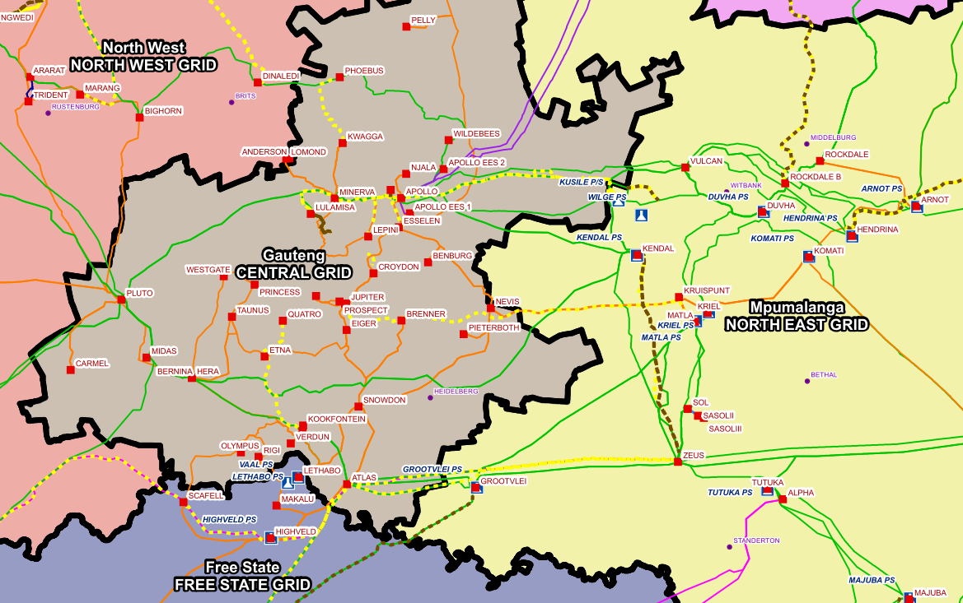
Geographical Location
Affected Substations

Slide 9
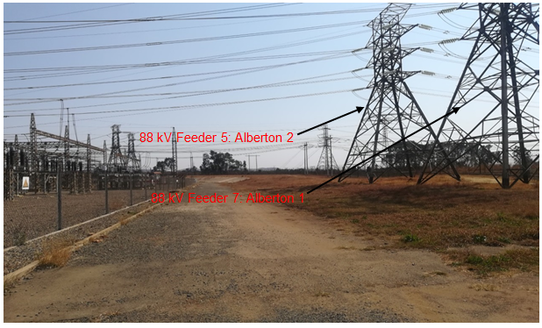
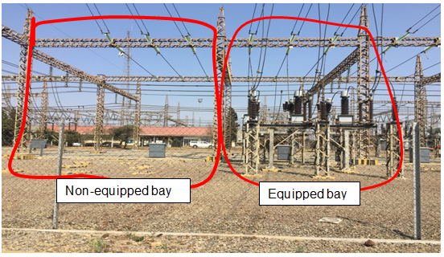
Alberton 1 and 2 Alternative solution

Slide 10
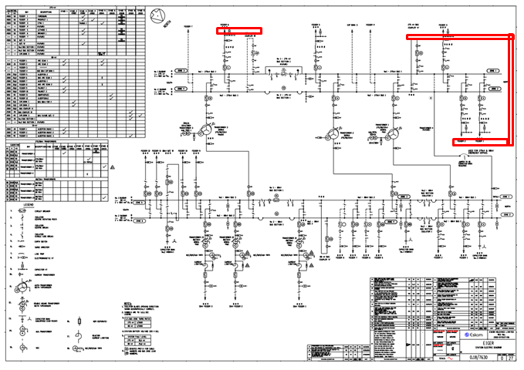
Proposed bypass route 1

Slide 11
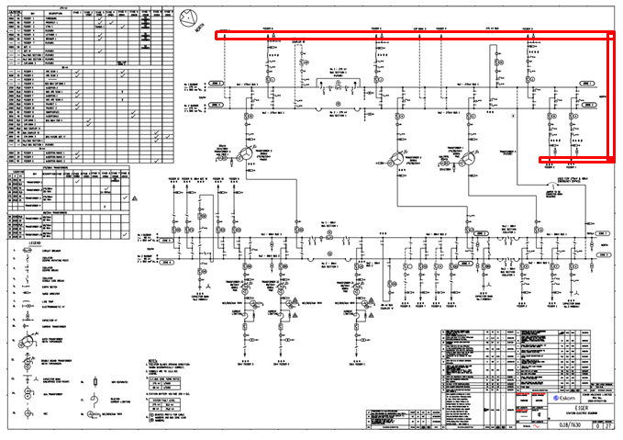
Route 2

Slide 12
Selection process
Route 2 was selected
Reasons:
No need to equip the buscoupler bay (cost and time saving).
Replacing strain woodpoles with suspension poles (cost saving).
Only need 1 feeder to energize the underpass.
Caters for future work.

Slide 13
Line summary Eiger- 275 kV
LINE | LENGTH (Km) | CONDUCTOR BUNDLE | RATE A (MVA) | RATE B (MVA) | TEMPLATE TEMPERATURE
Eiger-Brenner | 43 | 4 x Zebra | 1353 | 1947 | 50°C
Eiger-Etna | 33 | 4 x Zebra | 1353 | 1947 | 50°C
Eiger-Fordsburg | 19 | 4 x Bear | 993 | 1461 | 50°C
Eiger-Prospect | 19 | 4 x Bear | 993 | 1461 | 50°C
Proposed bypass | 0.5 | 2 x Bull | 1445 | 2017 | 70°C

Slide 14
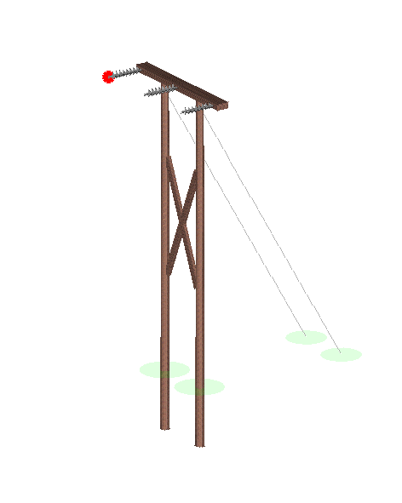
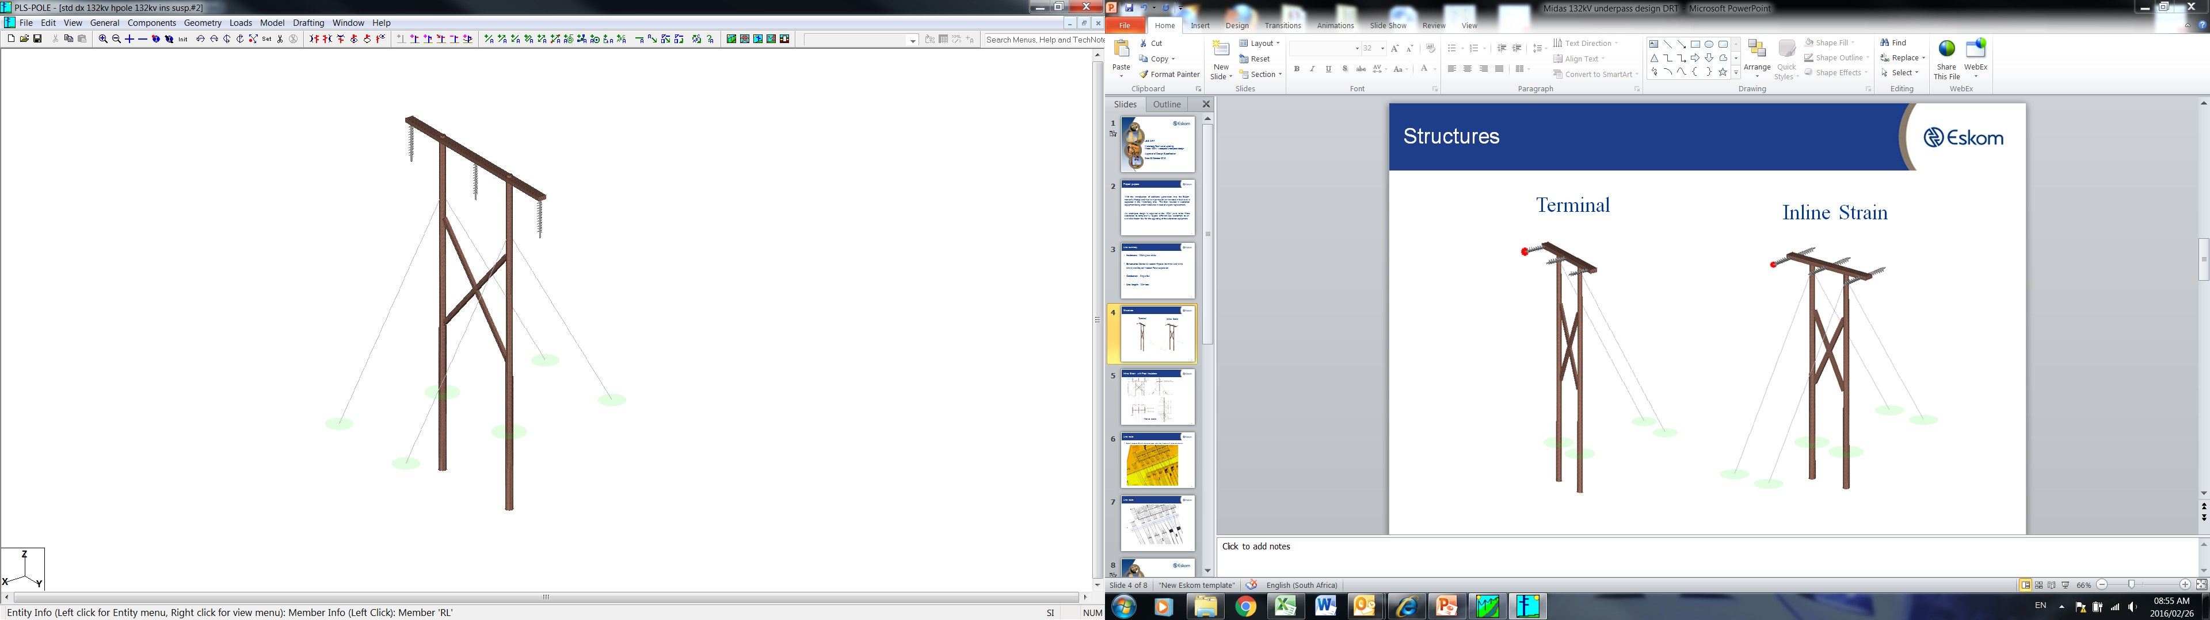
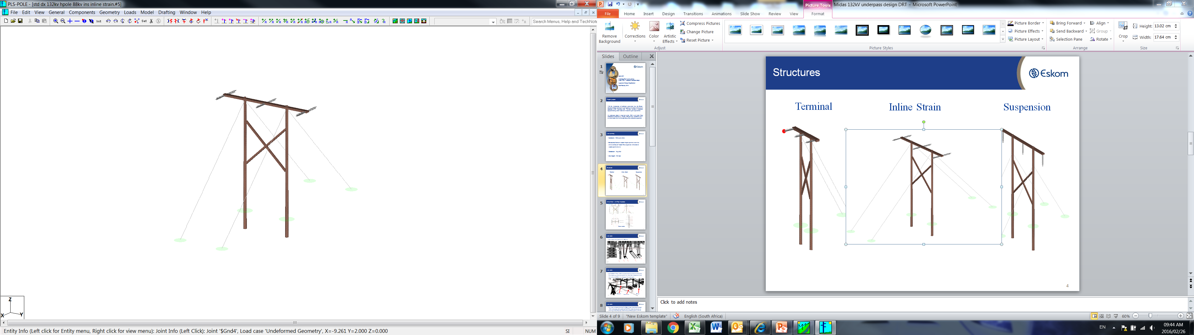
Structures
Terminal
Inline Strain
Suspension

Slide 15
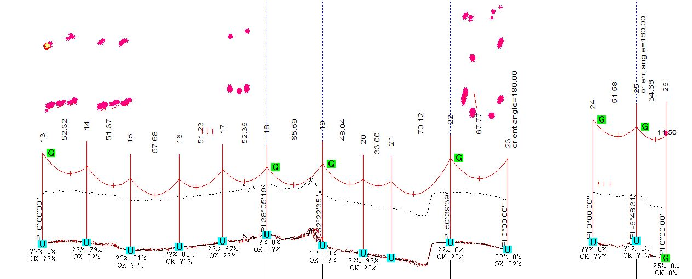
Crossings and clearance checks
Etna
Brenner
Lethabo
Buscoupler A
Ground clearance

Slide 16
Clearance results
Clearance checks from the lines above to the bypass below. Criteria for the clearance checks were done as specified below:
A-The higher line at templating temperature and the lower line at cold (-5ºC)
B-The higher line at templating temperature and the lower line at maximum swing
B-The higher line at moderate swing with the lower line at maximum swing
Lines | A (m) | B (m) | C (m)
Brenner | 3.835 | 3.759 | 5.201
Lethabo | 5.988 | 5.026 | 6.319
Buscoupler A | 4.930 | 4.075 | 4.543
Etna | 8.499 | 7.8 | 8.7
Fordsburg | 6.039 | 5.785 | 6.173
Prosburg | 5.503 | 5.261 | 5.894

Slide 17
Insulator selection
Eiger substation
275kV bypass
Method:
Nominal voltage
Dry arcing distance (SANS 10280)
BIL
SIL
Type of insulator
Glass insulators
Composite insulators
Pollution level
Specific creepage distance (IEC 60815)
Conductor mechanical loading
Insulator strength (IEC 60120)

Slide 18
Insulator selection
Insulator Material | Long-Rod Composite
System Nominal Voltage | 132kV
Insulator strength | 210kN
Specific Creepage Distance [mm/kV] | 25
Dry Arcing Distance [mm] | ≥1450
End-fitting Size [mm] | 20
BIL [kV] | 550

Slide 19
Future work/activities
The following activities will be performed in future:
HVDC project
Investigations on Minerva-Vulcan and Apollo-Thuso lines
Etna-Glockner 400kV Line

Slide 20
Value added to me
Understating the importance of each department and how their contribution sustains the business.
Application of theoretical knowledge in practical situations
Improvement on communication and networking skills
The awareness of standards
20

Slide 21
Value added to the business
During the past six months of training, I was given projects that provided me the platform to add value to the business.
Grounding impedance measurement
Insulator selection
Masa-Ngwedi site visit
Routine tests
21

